Slide 1
Mini Project 3 Othello AI
Due: 6/28 (Mon)

Slide 2
Outline
Introduction
Othello
State Value Function
Minimax
Alpha-Beta Pruning
How To Design Your AI
Package
Requirements
Grading

Slide 3
Outline
Introduction
Othello
State Value Function
Minimax
Alpha-Beta Pruning
How To Design Your AI
Package
Requirements
Grading

Slide 4
Introduction
Design and implement an AI that can play the boardgame Othello
Read the current board and output the next move
Design a state value function to evaluate the score of the board
Determine the next move with tree search algorithm

Slide 5
Outline
Introduction
Othello
State Value Function
Minimax
Alpha-Beta Pruning
How To Design Your AI
Package
Requirements
Grading

Slide 6
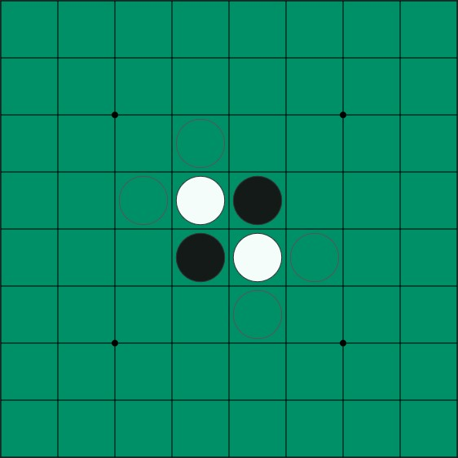
Othello (Reversi)
Source: https://www.eothello.com/

Slide 7
Othello Rules
Use black and white discs and an 8 x 8 board, black plays first
Starts with initial board (the board on the previous page)
Player can place disc if the new disc and another same color disc are on a line (horizontal, vertical, diagonal), with one or more contiguous opposite color discs between the two discs of the player
The opposite color discs between player discs will be flipped
Player passes if no valid move can be performed
The game ends when neither player can move
The one with more discs wins

Slide 8
Othello Rules
Use black and white discs and an 8 x 8 board, black plays first
Starts with initial board (the board on the previous page)
Player can place disc if the new disc and another same color disc are on a line (horizontal, vertical, diagonal), with one or more contiguous opposite color discs between the two discs of the player
The opposite color discs between player discs will be flipped
Player passes if no valid move can be performed
The game ends when neither player can move
The one with more discs wins

Slide 9
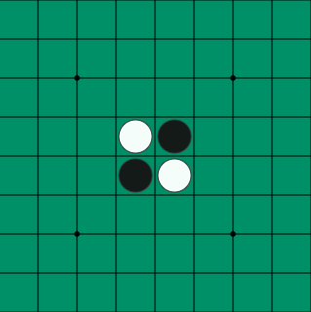
Initial board
Source: https://www.eothello.com/

Slide 10
Othello Rules
Use black and white discs and an 8 x 8 board, black plays first
Starts with initial board (the board on the previous page)
Player can place disc if the new disc and another same color disc are on a line (horizontal, vertical, diagonal), with one or more contiguous opposite color discs between the two discs of the player
The opposite color discs between player discs will be flipped
Player passes if no valid move can be performed
The game ends when neither player can move
The one with more discs wins

Slide 11
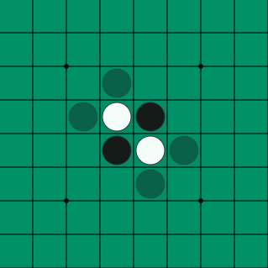
Gray discs are valid moves of black
Source: https://www.eothello.com/

Slide 12
Othello Rules
Use black and white discs and an 8 x 8 board, black plays first
Starts with initial board (the board on the previous page)
Player can place disc if the new disc and another same color disc are on a line (horizontal, vertical, diagonal), with one or more contiguous opposite color discs between the two discs of the player
The opposite color discs between player discs will be flipped
Player passes if no valid move can be performed
The game ends when neither player can move
The one with more discs wins

Slide 13
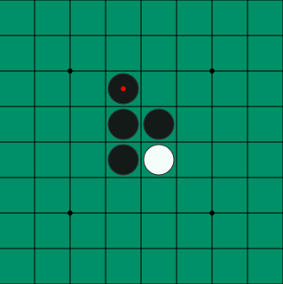
Black plays (2, 3), one white disc is flipped
Source: https://www.eothello.com/

Slide 14
Othello Rules
Use black and white discs and an 8 x 8 board, black plays first
Starts with initial board (the board on the previous page)
Player can place disc if the new disc and another same color disc are on a line (horizontal, vertical, diagonal), with one or more contiguous opposite color discs between the two discs of the player
The opposite color discs between player discs will be flipped
Player passes if no valid move can be performed
The game ends when neither player can move
The one with more discs wins

Slide 15
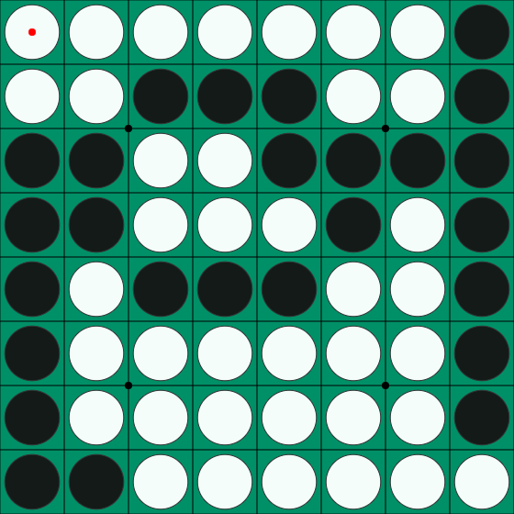
Since neither player can move, game ends
Source: https://www.eothello.com/

Slide 16
Othello Rules
Use black and white discs and an 8 x 8 board, black plays first
Starts with initial board (the board on the previous page)
Player can place disc if the new disc and another same color disc are on a line (horizontal, vertical, diagonal), with one or more contiguous opposite color discs between the two discs of the player
The opposite color discs between player discs will be flipped
Player passes if no valid move can be performed
The game ends when neither player can move
The one with more discs wins

Slide 17
White wins with more discs
Source: https://www.eothello.com/

Slide 18
Outline
Introduction
Othello
State Value Function
Minimax
Alpha-Beta Pruning
How To Design Your AI
Package
Requirements
Grading

Slide 19
State Value Function
The program should decide which move is better
We can pick the move which leads to the board with highest score
Thus, we need a function to evaluate the score of the board
It is the “state value function”

Slide 20
State Value Function
State => the board
Value => how “good” the board is
Function => given a board, output the value

Slide 21
Simple Example
According to the Othello rule, we win if we have more discs than the opponent when the game ends
Thus, we can define a simple value function:
Value = player discs – opponent discs

Slide 22
Suppose we play as black, value = 4 – 1 = 3
Source: https://www.eothello.com/

Slide 23
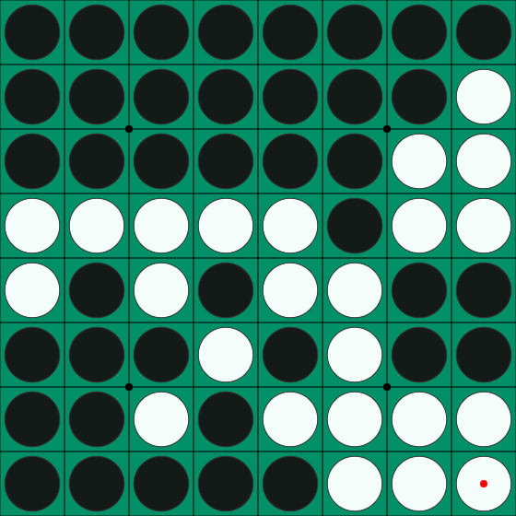
Another example, value = 40 – 24 = 16
Source: https://www.eothello.com/

Slide 24
Use value function to pick the next move
Suppose we have three valid moves, A, B, and C:
Current
Move A
Move C
Move B
After
Move A
After
Move B
After
Move C

Slide 25
Use value function to pick the next move
After evaluating the state values, we have 20, -15, and 30
Current
Move A
Move C
Move B
Value
20
Value
-15
Value
30

Slide 26
Use value function to pick the next move
We pick move C to be our next step since it leads to the highest value
Current
Move A
Move C
Move B
Value
20
Value
-15
Value
30

Slide 27
Stronger Value Functions
The value function in the previous example is too simple
It is nearly impossible to beat the baselines by using it
In this mini project, you must design a stronger value function to evaluate how “good” the board is

Slide 28
Features You Can Utilize
Disc count
Valid move count
Disc position
Game status (win, lose, skipped turn)
Try to figure out more features by yourself

Slide 29
Outline
Introduction
Othello
State Value Function
Minimax
Alpha-Beta Pruning
How To Design Your AI
Package
Requirements
Grading

Slide 30
Minimax
In the previous example, we only look forward for one step
However, the opponent will try its best to defeat you
Greedy choice is not always the best
We should look forward for more steps and simulate how the opponent thinks to make the best choice with least risk

Slide 31
Minimax
Player tries its best to win
Player picks the move with the highest score
Opponent tries its best to defeat the player
Opponent picks the move with the lowest “player’s value function” score
That is, opponent tends to give the player the worst board
The Minimax algorithm is based on this player-opponent interaction

Slide 32
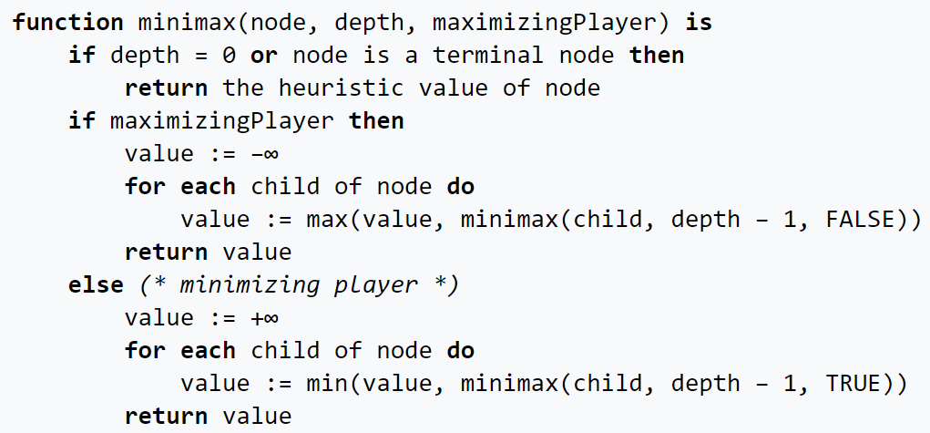
Minimax Pseudocode
Source: https://en.wikipedia.org/wiki/Minimax

Slide 33
Example
Now
:Player
:Opponent
A
B
C
D
E
F
G
H
I
J
K

Slide 34
Evaluate score at leaves
Now
:Player
:Opponent
A
B
C
D
E
F
G
H
I
J
K
5

Slide 35
Evaluate score at leaves
Now
:Player
:Opponent
A
B
C
D
E
F
G
H
I
J
K
5
6

Slide 36
Player picks the largest score
Now
:Player
:Opponent
A
B
C
D
E
6
F
G
H
I
J
K
5
6

Slide 37
Evaluate score at leaves
Now
:Player
:Opponent
A
B
C
D
E
6
F
G
H
I
J
K
5
6
7

Slide 38
Evaluate score at leaves
Now
:Player
:Opponent
A
B
C
D
E
6
F
G
H
I
J
K
5
6
7
4

Slide 39
Evaluate score at leaves
Now
:Player
:Opponent
A
B
C
D
E
6
F
G
H
I
J
K
5
6
7
4
5

Slide 40
Player picks the largest score
Now
:Player
:Opponent
A
B
C
D
E
6
7
F
G
H
I
J
K
5
6
7
4
5

Slide 41
Opponent picks the smallest score
Now
:Player
:Opponent
A
B
6
C
D
E
6
7
F
G
H
I
J
K
5
6
7
4
5

Slide 42
Evaluate score at leaves
Now
:Player
:Opponent
A
B
6
C
D
E
6
7
F
G
H
I
J
K
5
6
7
4
5
3

Slide 43
Player picks the largest score
Now
:Player
:Opponent
A
B
6
C
D
E
6
7
3
F
G
H
I
J
K
5
6
7
4
5
3

Slide 44
Opponent picks the smallest score
Now
:Player
:Opponent
A
B
6
3
C
D
E
6
7
3
F
G
H
I
J
K
5
6
7
4
5
3

Slide 45
Move A has the largest score
Now
:Player
:Opponent
A
B
6
3
C
D
E
6
7
3
F
G
H
I
J
K
5
6
7
4
5
3

Slide 46
Player picks move A to be the next move
Now
:Player
:Opponent
A
B
6
3
C
D
E
6
7
3
F
G
H
I
J
K
5
6
7
4
5
3

Slide 47
Outline
Introduction
Othello
State Value Function
Minimax
Alpha-Beta Pruning
How To Design Your AI
Package
Requirements
Grading

Slide 48
Alpha-Beta Pruning
By Minimax, we can simulate our opponent’s moves and pick a move with minimum risk and maximum value
Looking forward for more steps may improve the policy
However, the size of the search tree may drastically increase with the increase of search depth

Slide 49
Alpha-Beta Pruning
Since we only have limited time, if we hope to increase search depth, we must optimize the search process
There are many branches in the minimax process which is not related to the result
We can try to “prune” these branches to improve efficiency
The Alpha-Beta Pruning is the improved version of Minimax method which eliminates some unnecessary branches

Slide 50
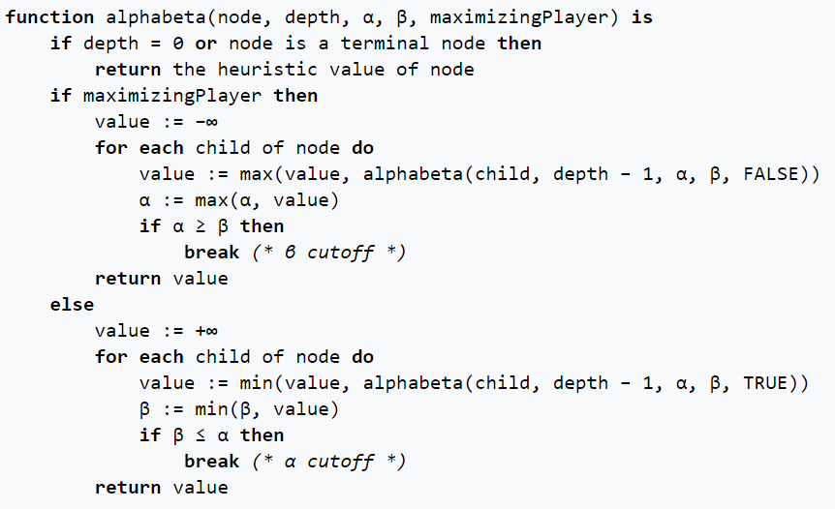
Alpha-Beta Pruning Pseudocode
Source: https://en.wikipedia.org/wiki/Alpha%E2%80%93beta_pruning

Slide 51
Alpha-Beta Pruning
Alpha: the maximum score that the player is assured of in the current search process
Beta: the minimum score that the opponent is assured of in the current search process

Slide 52
Alpha-Beta Pruning
If alpha >= beta on a player node, we can stop to search on this branch
In this situation, the player will return a value >= beta on this branch
However, the opponent already has a better choice (beta)
Thus, no matter the later discovered value on this branch, the opponent will not pick this branch
We can “prune” this branch since it will not affect the result
We can also stop to search if beta <= alpha on an opponent node

Slide 53
Example
Now
α: -INF
β: INF
:Player
:Opponent
A
B
α: -INF
β: INF
C
D
E
α: -INF
β: INF
F
G
H
I
J
K

Slide 54
Evaluate score at leaves
Now
α: -INF
β: INF
:Player
:Opponent
A
B
α: -INF
β: INF
C
D
E
α: -INF
β: INF
F
G
H
I
J
K
5

Slide 55
Update alpha
Now
α: -INF
β: INF
:Player
:Opponent
A
B
α: -INF
β: INF
C
D
E
α: 5
β: INF
F
G
H
I
J
K
5

Slide 56
Evaluate score at leaves
Now
α: -INF
β: INF
:Player
:Opponent
A
B
α: -INF
β: INF
C
D
E
α: 5
β: INF
F
G
H
I
J
K
5
6

Slide 57
Update alpha
Now
α: -INF
β: INF
:Player
:Opponent
A
B
α: -INF
β: INF
C
D
E
α: 6
β: INF
F
G
H
I
J
K
5
6

Slide 58
Player picks the largest score
Now
α: -INF
β: INF
:Player
:Opponent
A
B
α: -INF
β: INF
C
D
E
6
α: 6
β: INF
F
G
H
I
J
K
5
6

Slide 59
Update beta
Now
α: -INF
β: INF
:Player
:Opponent
A
B
α: -INF
β: 6
C
D
E
6
α: 6
β: INF
F
G
H
I
J
K
5
6

Slide 60
Propagate alpha and beta values
Now
α: -INF
β: INF
:Player
:Opponent
A
B
α: -INF
β: 6
C
D
E
6
α: 6
β: INF
α: -INF
β: 6
F
G
H
I
J
K
5
6

Slide 61
Evaluate score at leaves
Now
α: -INF
β: INF
:Player
:Opponent
A
B
α: -INF
β: 6
C
D
E
6
α: 6
β: INF
α: -INF
β: 6
F
G
H
I
J
K
5
6
7

Slide 62
Update alpha
Now
α: -INF
β: INF
:Player
:Opponent
A
B
α: -INF
β: 6
C
D
E
6
α: 6
β: INF
α: 7
β: 6
F
G
H
I
J
K
5
6
7

Slide 63
Alpha >= beta in a player node, stop searching
Now
α: -INF
β: INF
:Player
:Opponent
A
B
α: -INF
β: 6
C
D
E
6
α: 6
β: INF
7
α: 7
β: 6
F
G
H
I
J
K
5
6
7

Slide 64
Opponent picks the smallest score
Now
α: -INF
β: INF
:Player
:Opponent
A
B
6
α: -INF
β: 6
C
D
E
6
α: 6
β: INF
7
α: 7
β: 6
F
G
H
I
J
K
5
6
7

Slide 65
Alpha-Beta Pruning
In the example above, we use the same search tree as Minimax
By pruning, we eliminate branches I and J
However, we still get the same result on branch A
Alpha-Beta Pruning can effectively speed up the process while maintaining the same result

Slide 66
Outline
Introduction
Othello
State Value Function
Minimax
Alpha-Beta Pruning
How To Design Your AI
Package
Requirements
Grading

Slide 67
How To Design Your AI
The game runner (main.cpp) executes the AIs of the player and the opponent in turns and communicates with them by files
Your game AI should read the board status and available moves from the file “state”
Your game AI should output your move to the file “action”

Slide 68
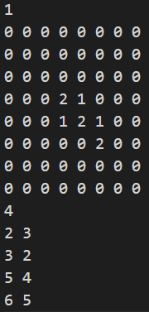
State file
The state file consists of four parts:
Current player (1 or 2)
Board (8 x 8 matrix)
Valid move number
List of valid moves

Slide 69

Action file
Your AI should output the next move to the “action” file
You can keep output moves in the time limit
Only the last complete output will be considered
In the case on the right, (3, 5) will be accepted by the game runner
You lose if you outputs an invalid move

Slide 70
How To Design Your AI
You can refer to the “player_random.cpp” in the “src” folder of the package we provided
Design your state value function to evaluate the board
Implement the Alpha-Beta Pruning method and use your value function in the search process
Run Alpha-Beta Pruning and decide which move to output

Slide 71
Outline
Introduction
Othello
State Value Function
Minimax
Alpha-Beta Pruning
How To Design Your AI
Package
Requirements
Grading

Slide 72
Package Directory Structure
Mini Project 3
baseline
windows
baseline<i>.exe, i := {1, 2, 3, 4, 5}
linux
baseline<i>, i := {1, 2, 3, 4, 5}
mac
baseline<i>, i := {1, 2, 3, 4, 5}
src
main.cpp
makefile
player_<description>.cpp, description := {random, infinite, partial, invalid}
Mini Project 3 Introduction.pptx
Mini Project 3 Spec.pdf

Slide 73
Baseline
The baseline folder contains executables of the baselines
If you use Windows, use the baselines in the windows folder
If you use Linux, use the baselines in the linux folder
If you use Mac, use the baselines in the mac folder
We will use these baselines to test the performance of your program
Test your program against these baselines and try to defeat them

Slide 74
Baseline
baseline1 => pure random
baseline2 => minimax with basic value function
baseline3 => deeper minimax with basic value function
baseline4 => alpha beta pruning with advanced value function
baseline5 => deeper alpha beta pruning with advanced value function

Slide 75
Src
The src folder contains the main program, a makefile and some provided example programs
The main.cpp is the game runner, do not modify it
However, you can refer to it when implementing game simulation of minimax
The makefile helps you compile your code
You can also compile by hand, make sure you set the flags -Wall and -Wextra

Slide 76
Src
The example programs are some situations you might face while testing your program
player_random.cpp => the pure random AI
You can refer to this one and write your own code
player_infinite.cpp => only the last move you output in your turn will be considered
player_invalid.cpp => you lose if you output an invalid move
player_partial.cpp => moves in incomplete format will not be considered

Slide 77
How To Compile Your Code
To compile all programs:
Type make when your working directory is ‘src’
To compile <program_name>.cpp:
Type make <program_name> when your working directory is ‘src’
To clean the executables:
Type make clean when your working directory is ‘src’

Slide 78
How To Test Your Code
If you use Windows, type the command below in cmd:
main.exe <AI1>.exe <AI2>.exe
If you use Linux / Max, type the command below in terminal:
./main ./<AI1> ./<AI2>

Slide 79
Outline
Introduction
Othello
State Value Function
Minimax
Alpha-Beta Pruning
How To Design Your AI
Package
Requirements
Grading

Slide 80
Requirements - Code
Design and implement an AI that can play the boardgame Othello
Your AI should read the board from file and write next move to file
Design a value function to evaluate the score of the board
Enhance the policy of your AI with Alpha-Beta Pruning

Slide 81
Requirements - Code
If you are not satisfied by the Alpha-Beta Pruning algorithm, you can try some more advanced methods. However, make sure you can explain how Minimax and Alpha-Beta Pruning works during demo
If you cannot complete the Alpha-Beta Pruning algorithm, implementing the basic Minimax algorithm also gives you some score

Slide 82
Requirements - Code
You will lose immediately if your program outputs an invalid move
Time limit for each move is 10 seconds, and the memory limit is 4GB
You can keep output moves in the limited time. Only the last successful output move is used by the game runner
Please refer to the spec for more detailed rules

Slide 83
Requirements - Submission
Please use C++ and write your program in a single file
Your program should be named as <student_id>_project3.cpp
Your program will be compiled in a GNU / Linux environment by:
g++ -O2 -std=c++14 -Wall -Wextra <student_id>_project3.cpp
Please make sure your program can be compiled by the command above with no error

Slide 84
Requirements - Report and Demo
You should write a report to elaborate on how you design your AI
The report is not directly graded, but is your only available reference through the TA demo (You cannot refer to your code in demo)
You must attend the demo and answer the questions from TA
The demo date and method will be announced soon

Slide 85
Outline
Introduction
Othello
State Value Function
Minimax
Alpha-Beta Pruning
How To Design Your AI
Package
Requirements
Grading

Slide 86
Grading
The project accounts for 9 points of your total grade
Beat every baseline => +5 points (1 point for each baseline)
Implement Tree search (Minimax) => +2 points
Design of your state value function => +1 point
Implement Alpha-Beta Pruning => +1 point

Slide 87
Grading Bonus
(Bonus) Uses version control software => +1 point
Include a screenshot with more than 3 commits in your report
(Bonus) Class ranking => At most +2 points
You can attend the class ranking if you beat all baselines
Your AI will play against other AIs of your classmates and gain bonus score according to your ranking

Slide 88
Happy Coding!

